Slide 1
Evolutionary Algorithmic Gaming
Implementation of Genetic Algorithms in gaming
By, Rashmi P Nayak
Rakesh G
D Praveen Kumar

Slide 2
ABSTRACT
Applying genetic algorithm over simple JavaScript game to simulate the process of Machine Learning.
Rockets teach themselves on how to avoid obstacles and reach the destined target.
The genetic algorithm is inspired by biological counterparts of reproduction, mutation, recombination and selection.
A fitness function determines the quality of the solution. The above mentioned factors affect and determine the evolution of the population.

Slide 3
Machine Learning
Machine learning is a field of computer science that gives computers the ability to learn without being explicitly programmed.
There are various sub-fields in machine learning:-
Supervised Learning
Clustering
Reinforcement Learning
Neural Networks
Evolutionary Algorithms
Anomaly Detection

Slide 4
Evolutionary Algorithms
Evolutionary algorithms are a generic population-based optimization algorithms. An EA uses mechanisms inspired by biological evolution, such as reproduction, mutation, recombination, and selection. Fitness function determines the quality of the solutions. Evolution of the population then takes place after the repeated application of the above operators.
Various Techniques:
Genetic Algorithm
Gene Expression Programming
Differential Evolution

Slide 5
Genetic Algorithm
Genetic algorithm (GA) is inspired by the process of natural selection. Genetic algorithms are commonly used to generate high-quality solutions by relying on bio-inspired operators such as mutation, crossover and selection.
Selection: We use a fitness function to evaluate performance of each individual entity. Based on the value of fitness, we select a group of entities and rank them in order of best.
Crossover: We multiply the selected individuals by breeding them to form a new population
Mutation: We use a mutation rate to mutate some entities a little to create diversity in the population, in order to avoid stalling at local maximum

Slide 6
Smart Rockets with GA
The objective of this game is for the rockets to reach their target by avoiding the obstacles.
The target can be placed at a different point with a mouse-click by the user.
The track consists of multiple rectangular blocks.
At start, it is populated by many random rockets.
The rockets are given a life-time. The duration that they are allowed alive. The rockets must reach the target before theirs time ends.
The Genetic Algorithm analyses the rockets from each generation, and improves them over time by breeding the fittest of them and so on.

Slide 7
Working Principle
Create a population of specified number.
Generate random DNA units to fill the population. Each DNA is an array of Vectors, that drive the rocket along a direction
Selection:
Calculate fitness – 1/(Distance of Target – Distance of Rocket)
Crossover:
Select two parents
Find midpoint in the vector array, transfer vectors/genes of parent A till midpoint to child. Transfer vectors/genes from midpoint till end of parent B to child.
Mutate:
Generate random number from 0 – 1. Check if its lesser than provided mutation rate m. If lesser, perform mutation.
i.e., Create random new vectors in the passed DNA/Rocket.

Slide 8
EXISTING AI SYSTEM
There are various AI systems on the current generation games. However these systems are static, i.e. the Artificial Intelligence does not improve its performance over time.
The system cannot adapt, improve or change over time.
These are widely used in various popular video games like FIFA, Need For Speed etc.
There are various pre-existing difficulties for the user to select.

Slide 9
PROPOSED SYSTEM ADVANTAGES
With the current model, we could develop an AI for games that develops and improves itself over time.
This could lead to a very skilled AI that is challenging for the player to beat.
The system can adapt to different players and suit their playing style.

Slide 10
USE CASE DIAGRAM
Random Initial Rockets
Position of target
Current Population
Player
Distance of rocket to goal
Mutation
Fitness Function
Crossover
Entity Selection

Slide 11
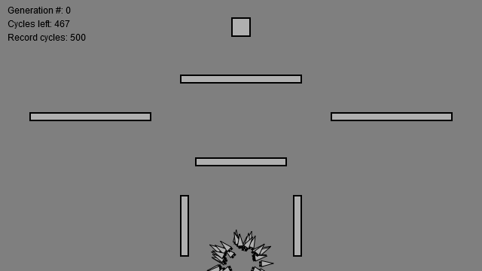
SCREENSHOTS

Slide 12
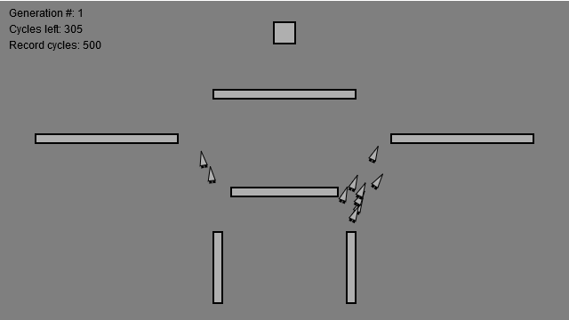
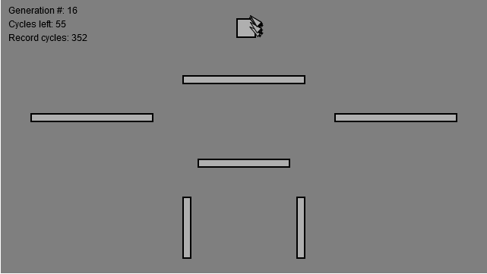

Slide 13
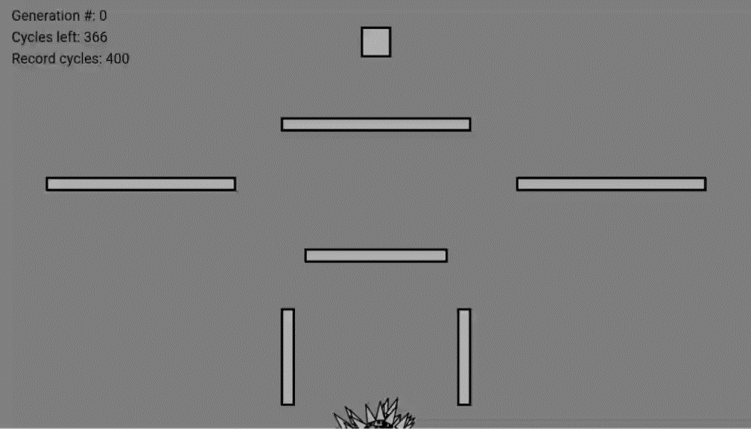

Slide 14
Thank You!

Slide 15
Thank You!

